Slide 1
Blazing Easels:
Expressive Arts
April 3, 2020
Created by BreeAnna Duell, Lily Crum, and Hannah Hagler
TURCHIN CENTER FOR THE VISUAL ARTS | tcva.org

Slide 2
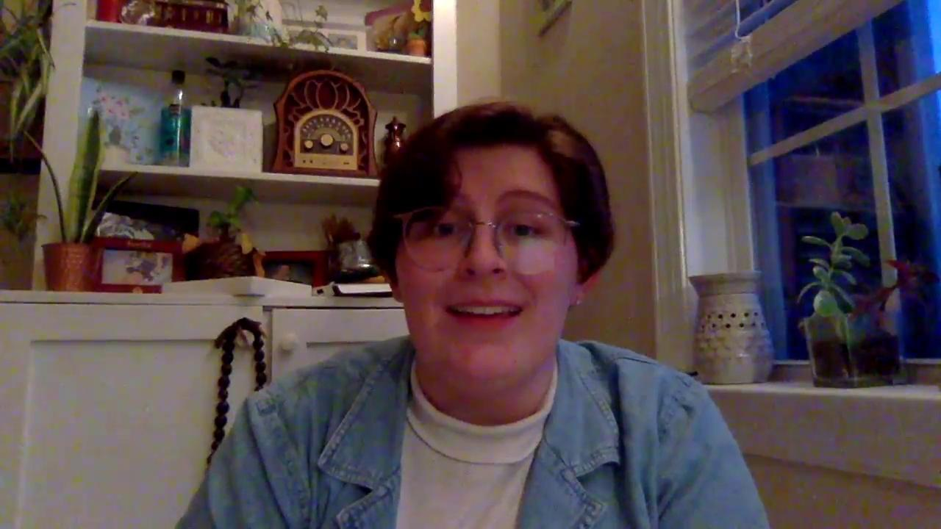
Introduction Video

Slide 3
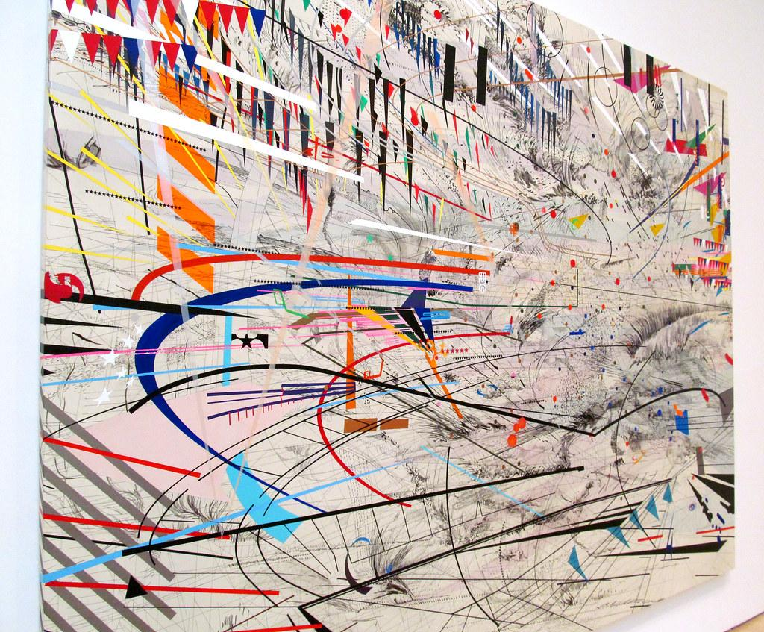
Expressive Arts
What are Expressive Arts?
Expressive Arts are methods of helping and healing that use the arts (visual/dance/music/theater/writing) as a guide to discovery and change.
While we make expressive art, we are able to better understand our emotions. You do not have to use words in your art to express a thought/feeling/idea/ or emotion!
Think about different kinds of lines… how might these lines portray different feelings? What about colors?
Julie Mehretu, Stadia I, 2004

Slide 4
Virtual Gallery Tour
As you explore the Expressive Arts 35th Anniversary Celebration exhibition in the Turchin Center’s Community Gallery, here are some questions to think about as you “walk” through the exhibit!
What materials are being used? How does that impact the artwork?
What colors do you see? How do those colors make you feel?
Can you tell what emotions the artist felt when they were making this?
Click the link to see the artwork! Turchin Center Gallery

Slide 5
Materials
Materials needed:
Something to draw on (paper, cardboard, etc)
Black marker (or crayon, pen, or black colored pencil)
Space needed for this lesson
Little space is needed! All you need is a place to draw
Time:
There is no restriction for how long this should take!

Slide 6
Instructions
Set up your work space. Gather materials you think you will want to use in your artwork.
Take a look at the list of music we have chosen for you. Choose a song.
First, take a black pen/marker/colored pencil and make various lines, shapes, or forms. Let the music guide you!
Next, choose colors that you want to use to express whatever you are feeling, and make marks on your artwork while continuing to listen to the music.
Repeat! Do the same thing for a couple more songs. See how the marks you make change from song to song.

Slide 7
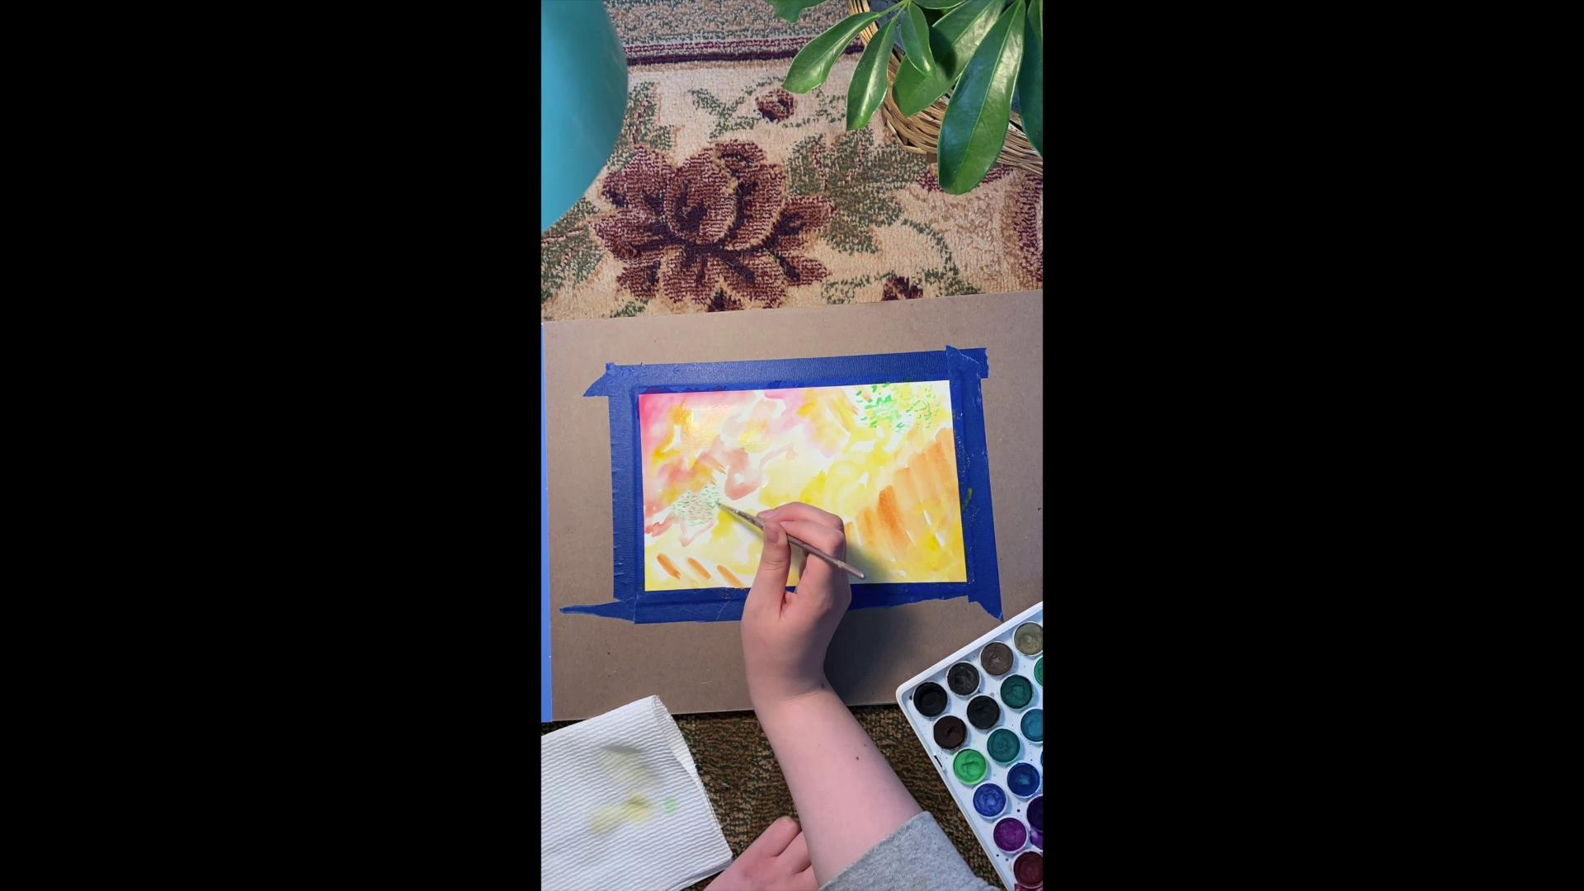
Here’s Some Inspiration!
We have each made a short video that will help you to better understand how to make visual expressive art while listening to music!

Slide 8
Music to Choose from
Upbeat Songs | Mellow Songs | Mix
Ji-Eun's Sunset Funky Jazz Happy Guitar Waking up on a picnic blanket | Relaxing Piano Music For Study and Focus Santo & Johnny - Sleep walk Enabling Environment | Married Life "Memories" (Music Box) by Michael Ortega Concerto Violin in D major Guitar Music

Slide 9
Share it!
Once you’ve created your work, talk to someone about it!
Although we may be apart, art can be a great way to start a conversation!
If you want to share your artwork online, use #TCVAatHome so we can see your work! (Ask an adult for help)

